Slide 1
ETL Basics
Lesson 2: ETL Process

Slide 2
Lesson Objectives
On completion of this lesson on Data Modeling, you will be able to understand:
The ETL process
The steps in Data Cleansing

Slide 3
The ETL Process
Source
Systems
Staging
Area
Presentation
System
Transform
Extract
Load

Slide 4
The ETL Process
Extract
Extract relevant data
Transform
Transform data to DW format
Build keys, etc.
Cleansing of data
Load
Load data into DW
Build aggregates, etc

Slide 5
EXTRACTION PHASE
Notes:
Now Let’ s go through that how Transforming data will take place in the Data Warehousing environment

Slide 6
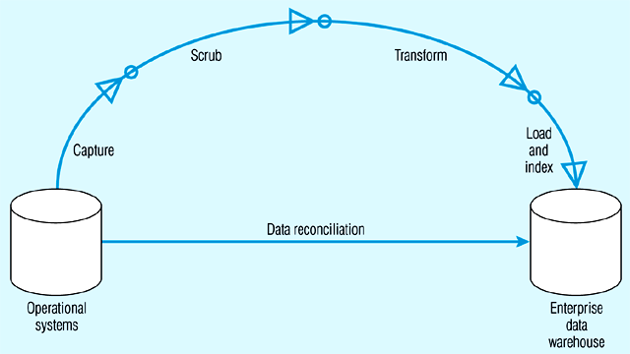
ETL – DATA CAPTURE
Capture = extract…obtaining a snapshot of a chosen subset of the source data for loading into the data warehouse
Static extract = capturing a snapshot of the source data at a point in time
Incremental extract = capturing changes that have occurred since the last static extract

Slide 7
Change Data Capture
Data warehousing involves the extraction and transportation of data from one or more databases into a target system or systems for analysis.
But this involves the extraction and transportation of huge volumes of data and is very expensive in both resources and time.
The ability to capture only the changed source data and to move it from a source to a target system(s) in real time is known as Change Data Capture (CDC).

Slide 8
Change Data Capture
CDC helps identify the data in the source system that has changed since the last extraction.
Set of software design patterns used to determine the data that has changed in a database.

Slide 9
Change Data Capture
Based on the Publisher/Subscriber model.
Publisher
Identifies the source tables from which the change data needs to be captured
Captures the change data and stores it in specially created change tables
Allows the subscribers controlled access to the change data
Subscriber
Subscriber needs to know what change data it is interested in
It creates a subscriber view to access the change data to which it has been granted access by the publisher

Slide 10
Data Staging
Often used as an interim step between data extraction and later steps
Accumulates data from asynchronous sources using native interfaces, flat files, FTP sessions, or other processes
At a predefined cutoff time, data in the staging file is transformed and loaded to the warehouse
There is usually no end user access to the staging file
An operational data store may be used for data staging
Notes:
Data staging is used in cleansing, transforming, and integrating the data.

Slide 11
Reasons for “Dirty” Data
Dummy Values
Absence of Data
Multipurpose Fields
Cryptic Data
Contradicting Data
Inappropriate Use of Address Lines
Violation of Business Rules
Reused Primary Keys,
Non-Unique Identifiers
Data Integration Problems

Slide 12
ETL – DATA Extraction
The extraction process can be done either by hand coded method or by using tools.
Advantages and disadvantages Of Custom-programmed )/Hand Coded Extraction (PL SQL Scripts) and Tool based extraction.
Tools have Well Defined disciplined approach and Documentation.
Tools provide an easier way to perform the extraction method by providing click, drag and drop features.
Hand coded extraction techniques allow extraction in cost effective manner since the PL/SQL construct are available with the RDBMS.
Hand coded extraction are used when the extraction is to be taken place where the programmer has clear data structure known.
Notes:
Though the extraction process can be done in either of the methods i.e either by hand coded methods or by using the tools. Tool based extraction have a well defined approach with a better documentation and it also makes the extraction process easier by a simple click, drag and drop features that are more user-friendly to the programmers.

Slide 13
ETL - Extraction Techniques
Extraction Technique
Bulk Extraction-
The entire data warehouse is refreshed periodically by extraction's from the source systems.
All applicable data are extracted from the source systems for loading into the warehouse.
This approach heavily uses the network connection for loading data from source to target databases, but such mechanism is easy to set up and maintain.
Notes:
Bulk extraction needs the entire data warehouse to be refreshed periodically in which the entire data which is there in the data warehouse and the data to be loaded in to the warehouse are loaded once again in to the warehouse which uses heavy network traffic. But this mechanism is much easier to set up and maintain .

Slide 14
Data Extraction
Capture of data from Source Systems
Important to decide the frequency of Extraction
Sometimes source data is copied to the target database using the replication capabilities of standard RDBMS (not recommended because of “dirty data” in the source systems)

Slide 15
Data Transformation
Transforms the data in accordance with the business rules and standards that have been established
Example include: format changes, de-duplication, splitting up fields, replacement of codes, derived values, and aggregates
Notes:
Aggregates, such as sales totals, are often precalculated and stored in the warehouse to speed queries that require summary totals.

Slide 16
Data Transformation
Validating
Process of ensuring that the data captured is accurate and transformation process is correct
E.g. Date of Birth of a Customer should not be more than today’s date

Slide 17
Data Transformation
Data Cleansing
Source systems contain “dirty data” that must be cleansed
ETL software contains rudimentary data cleansing capabilities
Specialized data cleansing software is often used.
Important for performing name and address correction and house holding functions
Leading data cleansing vendors include Vality (Integrity), Harte-Hanks (Trillium), and Firstlogic (i.d.Centric)
Notes:
Data cleansing is critical to customer relationship management initiatives.

Slide 18
Data Transformation
Steps in Data Cleansing
Parsing
Correcting
Standardizing
Matching
Consolidating
Conditioning
Enrichment
Notes:
A good example to use is cleansing customer data. Most students can identify with receiving multiple copies of the same catalog because the company is not doing a good data cleansing job.

Slide 19
Data Transformation
Parsing
Parsing locates and identifies individual data elements in the source files and then isolates these data elements in the target files
Examples include :
parsing the first, middle, and last name;
street number and street name; and city and state
Notes:
The record is broken down into atomic data elements.

Slide 20
Data Transformation
Parsing

Slide 21
Data Transformation
Correcting
Corrects parsed individual data components using sophisticated data algorithms and secondary data sources.
Example include replacing a vanity address and adding a zip code.
Notes:
External data, such as census data, is often used in this process.

Slide 22
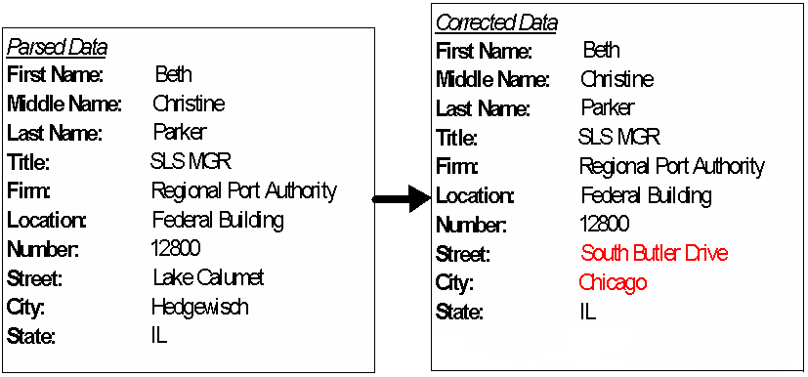
Data Transformation
Correcting

Slide 23
Data Transformation
Standardizing
Standardizing applies conversion routines to transform data into its preferred (and consistent) format using both standard and custom business rules.
Examples include adding a pre name, replacing a nickname, and using a preferred street name.
Notes:
Companies decide on the standards that they want to use.

Slide 24
Data Transformation
Standardizing

Slide 25
Data Transformation
Matching
Searching and matching records within and across the parsed, corrected and standardized data based on predefined business rules to eliminate duplications.
Examples include identifying similar names and addresses.
Notes:
Commercial data cleansing software often uses AI techniques to match records.

Slide 26
Data Transformation
Matching

Slide 27
Data Transformation
Consolidating
Analyzing and identifying relationships between matched records and consolidating/merging them into ONE representation.
Notes:
All of the data are now combined in a standard format.

Slide 28
Data Transformation
Consolidating

Slide 29
Data Transformation
Conditioning
The conversion of data types from the source to the target data store (warehouse) -- always a relational database
Eg. OLTP Date stored as text (DDMMYY); DW format is Oracle Date type

Slide 30
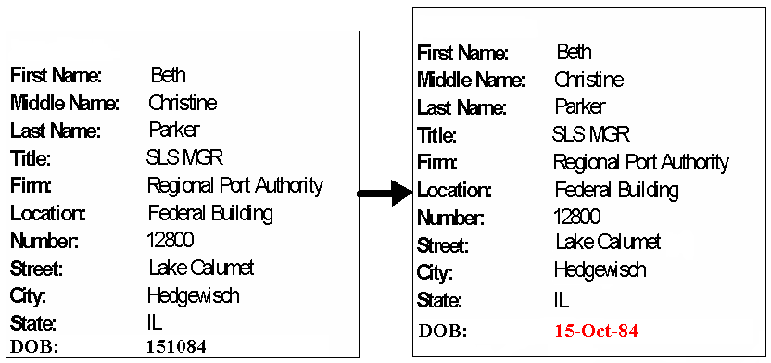
Data Transformation
Conditioning

Slide 31
Data Transformation
Enrichment
Adding/combining external data values, rules to enrich the information already existing in the data
E.g. If we can get a list that provides a relationship between Zip Code, City and State, then if a address field has Zip code 06905 it be safely assumed and address can be enriched by doing a lookup on this table to get Zip Code 06905 –> City Stamford –> State CT

Slide 32
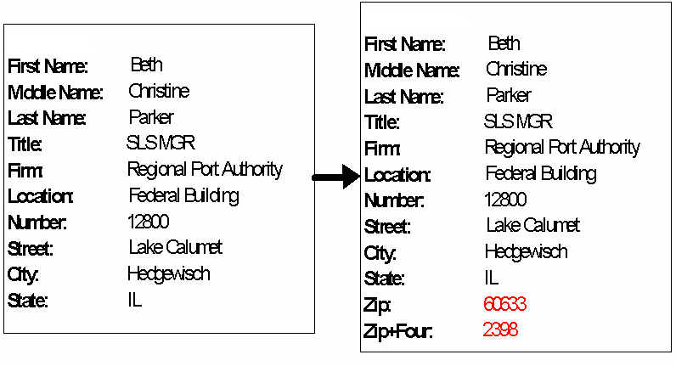
Data Transformation
Enrichment

Slide 33
Data Loading
Data are physically moved to the data warehouse
The loading takes place within a “load window”
Loading the Extracted and Transformed data into the Staging Area or Data Warehouse.
Notes:
Most loads involve only change data rather than a bulk reloading of all of the data in the warehouse.

Slide 34
Data Loading
First time bulk load to get the historical data into the Data Warehouse
Periodic Incremental loads to bring in modified data
Design load strategy to using appropriate Slowly Changing Dimension type .
The Loading window should be as small as possible
Should be clubbed with strong Error Management process to capture the failures or rejections in the Loading process

Slide 35
Slowly Changing Dimension Types
Three types of slowly changing dimensions
Type 1
Updates existing record with modifications
Does not maintain history
Type 2
Adds new record
Maintain history
Maintains old record
Type 3:
Keep old and new values in the existing row
Requires a design change

Slide 36
Meta Data
Data about data
Needed by both information technology personnel and users
IT personnel need to know data sources and targets; database, table and column names; refresh schedules; data usage measures; etc.
Users need to know entity/attribute definitions; reports/query tools available; report distribution information; help desk contact information, etc.
Notes:
The importance of meta data is now realized, even though creating it is not glamorous work.

Slide 37
Metadata
Metadata is more comprehensive and transcends the data.
Metadata provide the format and name of data items
It actually provides the context in which the data element exists.
provides information such as the domain of possible values;
the relation that data element has to others;
the data's business rules,
and even the origin of the data.
Notes:
Metadata is the high level core internal document of the source code which runs as the lifeblood for a data warehouse.
Metadata not only describe the format and name but it provides details about the context I,e what is the need of the data item and what are the values that the data item can have, the relationship between the data elements ie whether the data element is found on other locations and how they are inter-linked to each other. Apart from the technical details It also holds the business rule. The origin of the data is so critical that the end user might like to trace back to the origin of the data which end user sees through the OLAP tools.

Slide 38
Importance of Metadata
Metadata establish the context of the Warehouse data
Metadata facilitate the Analysis Process
Metadata are a form of Audit Trail for Data Transformation
Metadata Improve or Maintain Data Quality
Notes:
Importance of Metadata
Metadata establish the context of the Warehouse data
Metadata helps data warehouse administrators and users locate and understand data items, both in the source systems and in the warehouse data structures.
E.g.: The date 02/05/2010 could mean either May 2, 2010 or February 5, 2010 depending on the date convention used. Metadata describing the format of this date field could help determine the definite and unambiguous meaning of the data item.
Metadata facilitate the Analysis Process
Metadata must provide data warehouse end-users with the information they need to easily perform the analysis steps. It should thus allow users to quickly locate data that are in the warehouse.
Metadata should allow analysts to interpret data correctly by providing information about data formats and data definitions.

Slide 39
Notes:
Metadata are a form of Audit Trail for Data Transformation
Metadata document the transformation of source data into warehouse data. Hence warehouse metadata must be capable of explaining how a particular piece of warehouse data was derived from the operational systems.
All business rules governing the transformation of data to new values or new formats are also documented as metadata.
Metadata Improve or Maintain Data Quality
Metadata can improve or maintain warehouse data quality through the definition of valid values for individual warehouse data items. Using a data quality tool prior to actual loading into the warehouse, the warehouse load images can be reviewed to check for compliance with valid values for key data items. Data errors are quickly highlighted for correction.
Metadata can be used as the basis for any error-correction processing that should be done if a data error is found. Error-correction rules are documented in the metadata repository and executed by program code on an as needed basis.
All business rules governing the transformation of data to new values or new formats are also documented as metadata.
Metadata Improve or Maintain Data Quality
Metadata can improve or maintain warehouse data quality through the definition of valid values for individual warehouse data items. Using a data quality tool prior to actual loading into the warehouse, the warehouse load images can be reviewed to check for compliance with valid values for key data items. Data errors are quickly highlighted for correction.
Metadata can be used as the basis for any error-correction processing that should be done if a data error is found. Error-correction rules are documented in the metadata repository and executed by program code on a need basis.

Slide 40
Feature of ETL Tools
Support data extraction, cleansing, aggregation, reorganization, transformation, and load operations
Generate and maintain centralized metadata
Filter data, convert codes, calculate derived values, map source data fields to target data fields
Automatic generation of ETL programs
Closely integrated with RDBMS
High speed loading of target data warehouses using Engine-driven ETL Tools

Slide 41
Advantages of using ETL Tools
GUI based design of jobs – ease of development and maintenance
Generation of directly executable code
Engine driven technology is fast, efficient and multithreaded
In-memory data streaming for high-speed data processing
Products are easy to learn and require less training

Slide 42
Advantages of using ETL Tools
Automatic generation and maintenance of open, extensible metadata
Support for multiple data formats and platforms
Large number of vendor supplied data transformation objects

Slide 43
Example of ETL requirements
Integration of masters across different systems
E.g. State code AP could mean Andhra Pradesh in one system while it could mean Arunachal Pradesh in another
De-duplication of data from different systems
E.g. State Karnataka could be represented as KA in one system and KN in another system
Mapping of old codes to Data Warehouse codes
Data Cleansing - Changing to upper case, assigning defaults to unavailable data elements

Slide 44
Summary
In this module, you learned about the following:
ETL process
Cleansing steps
Notes:
Add the notes here.

